Slide 1
STARTUP
Unit 3

Slide 2
WHAT IS A STARTUP?
If it is incorporated as a private limited company (as defined in the Companies Act, 2013) or registered as a partnership firm .(registered under section 59 of the Partnership Act, 1932) or a limited liability partnership (under the Limited Liability Partnership Act, 2008) in India;
Up to seven years from the date of its incorporation/ registration; however, in the case of Startups in the biotechnology sector, the period shall be up to ten years from the date of its incorporation/ registration;
If its turnover for any of the financial years since incorporation/ registration has not exceeded Rupees 25 crores;
If it is working towards innovation, development or improvement of products or processes or services, or if it is a scalable business model with a high potential of employment generation or wealth creation.

Slide 3
Startup India Benefits
IPR Benfits
To promote awareness and adoption of IPRs by Startups and facilitate them in protecting and commercializing the IPRs, Startup India provides access to high quality Intellectual Property services and resources
1. Fast-tracking of Startup patent applications:
The patent application of Startups is fast-tracked for examination and disposal
2. Panel of facilitators to assist in filing of IP applications:
A panel of Facilitators is responsible for providing general advisory on different IPRs as also information on protecting and promoting IPRs in other countries.
3. Government to bear facilitation cost: Central Government bears the entire fees of the facilitators for any number of patents, trademarks or designs that a Startup may file, & Startups only bear the cost of the statutory fees payable.
4. Rebate on filing of application:
Startups are provided an 80% rebate in filing of patents vis-à-vis other companies. This helps them pare costs in the crucial formative years.
50% rebate is also provided in filing of Trademarks vis-à-vis other companies.

Slide 4
Relaxation in Public Procurement Norms
DIPP recognised Startups can now get listed as Sellers on the Government of India’s largest e-procurement portal. Government e-Marketplace! They are entitled to avail exemption on:
Prior Turnover and Experience requirements
Earnest Money Deposit requirements

Slide 5
Self-Certification under Labour and
Environment Laws
To reduce the regulatory burden on Startups thereby allowing them to focus on their core business and keep compliance cost low, Startups are allowed to self-certify their compliance under 6 Labour and 3 Environment laws for a period of 5 years from the date of incorporation.

Slide 6
Fund of Funds for Startups
To provide equity funding support for development and growth of innovation driven enterprises, the government has set aside a corpus fund of 10,000 crores managed by SIDBI.
The Fund is in the nature of Fund of Funds, which means that the Government participates in the capital of SEBI registered Venture Funds, who further invest in Startups.

Slide 7
Faster Exit for Startups
MCA has notified Startups as ‘fast track firms’ enabling them to wind up operations within 90 days vis-a-vis 180 days for other companies. An insolvency professional shall be appointed for the Startup, who shall be in charge of the company for liquidating its assets and paying its creditors within six months of filing an application in this regard.

Slide 8
Tax Exemption
IMB Certified
The Inter-Ministerial Board validates the innovative nature of the business for granting tax related benefits and is constituted by representatives from DIPP, DBT, DST and MEITY.
Startups incorporated on or after 1st April 2016 can apply for tax benefits and such innovative applications are then moderated by the Inter Ministerial Board before granting the certificate of eligibility.

Slide 9
Tax Exemption for 3 years
The profits of recognised Startups that are granted an Inter-Ministerial Board Certificate are exempted from income-tax for a period of 3 years (out of a block of 7 years). This fiscal exemption is aimed at facilitating growth of business and meeting the working capital requirements during the initial years of operations
Tax Exemption on Investment above Fair Market Value
If a Startup, having certificate from the Inter-Ministerial Board Certificate, receives any consideration for issue of shares that exceeds the face value of such shares, then the aggregate consideration received for such shares as exceeds the fair market value of the shares is exempted from tax.

Slide 10
RESOURCES FOR STARTUPS
Learning and Development Program
The website hosts a variety of courses which broadens the vision of budding entrepreneurs and guides them through the journey of their Startup venture. The program covers lessons on key areas of starting up by 40+ top founders of India in an extensive 4-week program. Not just that, upon completion of the course, the apprentice receives a certificate acknowledging their effort and certifying their learnings in the program.

Slide 11
Government Schemes
Many government departments are working to promote entrepreneurship in India. Startup India has collated various schemes from various ministerial bodies at one place to facilitate and save your time from jumping between websites!
State Government Policies
Startup India presents to you a list of 17 state government policies who offer benefits to Startups! Startups and entrepreneurs across these states can access the policy documents, website links and contact details of the respective nodal agencies.

Slide 12
Pro-Bono Services
In our endeavour to make starting up easy for startups,we bring you the best of some relevant services out there in the market free of cost, only for you. We have collaborated with leading corporates, the likes of Amazon Web Services, Zoho, Vakil search and others to bring you these services. Whether you want to build an app, use cloud credits or get cloud telephony services, everything here is free of cost for you.
Knowledge Bank
Registering a company is not a cake walk if you do not know the legalities. Startup India provides a knowledge bank detailing the requirements for starting a business in India; be it registering a company, filing IPRs, complying to tax policies or understanding the investor landscape in India! Startup India has got you covered and you do not need to spend time surfing the internet or gain information from disintegrated sources!

Slide 13
Market Research Reports
We understand the depth of knowledge you would require about your industry to scale new heights. We bring to you the latest market research reports by leading publishers such as Tracxn, Inc42 and NASSCOM.
Networking And Discussion
All members of the startup ecosystem – Startups, investors, mentors, incubators, accelerators and government bodies can connect with each other on this platform. The platform provides the eco system stakeholders with the opportunity to discuss – express and opine on the forum through discussion threads – blogs and one to one messaging.

Slide 14
10000 Startups
10,000 Startups aims at building a cross-collaborative platform to enable startups to grow to the next level by leveraging our network of investors, mentors, industry experts, and enterprises.
FAME MODEL(Funding, Acceleration, Mentoring, and Enterprise connects)
The 10,000 Startups FAME model is designed to facilitate the ideal connection between startups and Funders, Accelerators, Mentors, and Enterprises with complementary requirements, so that they may mutually benefit from each other

Slide 15
10000 NASSCOM
Funding: The NASSCOM 10,000 Startups programme helps shortlisted startups raise money from a wide range of investors- angels, micro VCs, VCs, and Government funds.
Acceleration: Once shortlisted for the programme, startups can work with the top accelerators. The NASSCOM 10,000 Startups programme presents unprecedented opportunities and a fast track into the top accelerators for shortlisted startups.
Mentoring: Focused group workshops are held for the shortlisted companies on Product Management, Go-to-Market Strategy, Pitching and Industry Insights from the experts.
Enterprise connect: Shortlisted startups get opportunities to showcase their product to top executives across industries and explore strategic partnerships, alliances, M&As , etc., and

Slide 16
PROGRAMS AND EVENTS
Apart from the FAME framework, we also offer a number of programs and events that are designed to help deserving startups through various stages of their growth
Warehouse Program :-
The Warehouse Program is the perfect package to provide fledgling companies with everything they’ll need for the initial stages of their startup journey, from a physical workspace and furniture, to expert guidance and networking opportunities.
Eligibility Criteria
Only startups with a minimum viable technology product are eligible to apply for this program. It is strongly suggested that the product be beyond its ideation phase.
Virtual program :-
Our Virtual Program is designed to help growth-stage startups that have their own workspaces take their business to new heights. The program creates the optimal environment for such startups to scale up by providing support in the form of a startup kit, and connecting the company with our widespread network of evaluators and mentors, who are also investors, accelerators, and industry veterans.
Eligibility Criteria :-
Startups in the growth stage that have a reasonable amount of traction with a product already out in the market may apply for the Virtual Program.

Slide 17
NASSCOM Industry Partnership Program
NASSCOM is India’s largest industry-backed corporate innovation program.
The NASSCOM Industry Partnership Program (NIPP) seeks to foster sustained engagement between large corporations and innovative technology ventures in India.
BENEFITS:-
Direct fast access to senior executives
Branding / PR evangelism
Access to executive mentoring, early technology, and deep expertise
Access to strategic investments and grants
Faster access to global markets and JV/OEM/partnership options
Participate in customer showcases, events, speaking opportunities, and delegations

Slide 18
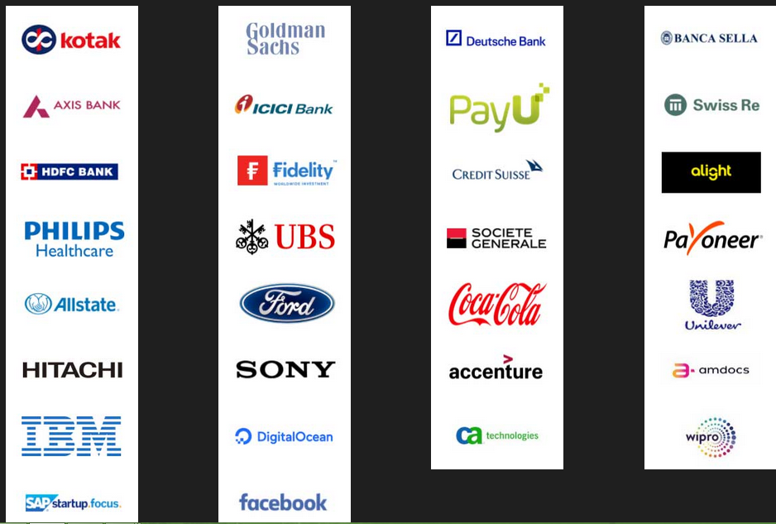
NIPP Partners

Slide 19
Rockstar program:-
The Rockstar Program is designed with the intent of making India a tech-innovation hub in the global arena. It will bring to the limelight innovations with disruptive potential, helping them gain worldwide recognition and trust.
RECOMMENDED CRITERIA :-
An IT product company incorporated in India whose product development is carried out in India or outside
An IP-backed company involved in technology product or technology platform, with the focus being on SaaS, IoT/robotics, blockchain, AI/ML/deep learning, and AR/VR
A company that has a commercialised product with paying customers
A company that stands out in emerging technologies with the domain focus being health, finance, retail, education, and enterprise

Slide 20
Nasscom Gaming Forum
NASSCOM ® is India’s premier trade body and chamber of commerce for the IT industry, and the NASSCOM Gaming Forum (NGF) was set up ten years ago to provide a common platform to share best practices and knowledge to developers and businesses within the Indian gaming industry, especially the burgeoning indie game dev community.
NASSCOM Game Developer Conference (NGDC)
The NASSCOM Game Developer Conference (NGDC) is India’s primary platform for creators and enthusiasts of computer, mobile, console, web, and social games to showcase, inspire, learn, and interact.

Slide 21
Nasscom Gaming Forum
NASSCOM Game Developer Conference (NGDC)
NGF Awards:-
Student game of the year
Indie game of the year
Studio Game of the Year
Upcoming Game of the year
BYOG
Incubation services
Game Jam Titans

Slide 22
BANK LOANS FOR START-UPS IN INDIA
UNIT - 3

Slide 23
BANK LOANS FOR STARTUPS-
Broadly, there are three loan categories that you could borrow into. These loans are specific to what your business currently needs.
1. Working Capital Loan:
Working capital is the money you need to meet your day-to-day business expenses like your monthly electricity bills. All your operational costs come under working capital and some loans are crafted to suit your working capital needs alone. The loans are offered typically for a 12-month tenure and have an interest rate of 12% to 16%. These can be either secured or unsecured.

Slide 24
2. Corporate Term Loan:
Term loans are used to start a venture or expand a business. Therefore, if you are starting up, you may want to look at term loans/funding. These are large sums of money borrowed from banks or financial institutions that are expected to be repaid over a longer period of time. These loans are secured (company assets) and have a longer tenure and the interest rate is negotiable. They can be converted into equity options and also have tax benefits.
3. Term Loan:
These loans are used to buy fixed assets. If you want to put up an office, you could consider borrowing a term loan. Typically, these loans are secured with a tenure of 1-10 years and a floating interest rate between 10 and 20%.

Slide 25
1. The Credit Guarantee Fund Scheme (CGS) for Micro and Small Enterprises
This scheme is run by the government of India in collaboration with SIDBI (Small Industries Development Bank of India) to give unsecured loans to businesses.
You can borrow up to Rs.100 Lakh in term loans or working capital loans as per your eligibility and feasibility.
The corpus of CGTMSE is being contributed by the GoI and SIDBI in the ratio of 4:1 respectively and has contributed Rs. 2477.78 crore to the corpus of the Trust up to May 31, 2016.

Slide 26
2. The MUDRA Loan Scheme
MUDRA stands for Micro Units Development and Refinance Agency Ltd.
It is an agency launched by the government of India to facilitate corporate term loans to entrepreneurs.
It was launched in 2015.

Slide 27
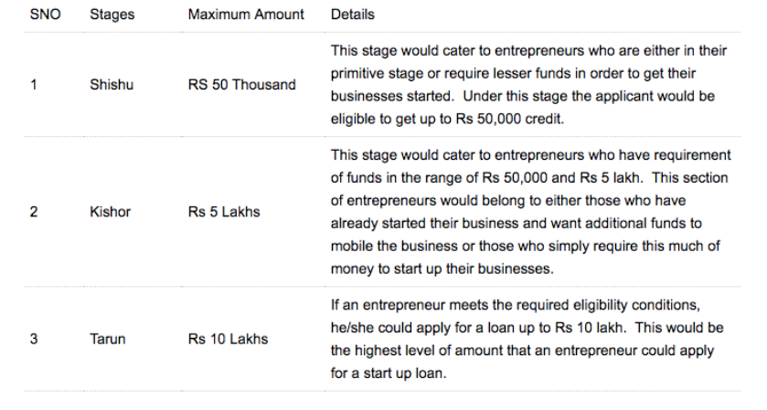

Slide 28
3. Stand Up India Scheme
The Stand Up India scheme is a special scheme started by the government of India to financially empower SC/ST and women entrepreneurs.
You can borrow between Rs. 10 lakh and Rs. 1 CR to start a manufacturing, trading or service unit, which is to be repaid in 7 years.

Slide 29
4. SIDBI Revolving Fund for Technology Innovation
It provides financial assistance to MSMEs towards development, up scaling, demonstration and commercialization of innovative technology based projects.
The assistance is given in the form of early stage “debt” funding on softer terms for development, demonstration and commercialization of new innovations in emerging technological areas, un-proven technologies, new products, process, etc. which have not been successfully commercialized so far.
Maximum assistance is generally not more than Rs. 1 crore per project. Interest rate would be as approved by the Project Approval Committee (PAC) (not be more than 5% p.a.).

Slide 30
5. Growth Capital and Equity Assistance
Who is it for-
Existing Small and Medium Businesses in need of Capital for Growth.
It provides assistance in form of Mezzanine/ Convertible Instruments, Subordinated debt and Equity (in deserving cases).

